Slide 1
Metagenomics
Greg Gloor
Department of Biochemistry
University of Western Ontario
ggloor@uwo.ca @gbgloor

Slide 2
Metagenomics
Characterizing all the constituents of a community of cells
Mainly microbial but can be applied to other mixtures of cells
Depends on good databases or de-novo assembly
Annotation is critical component
Bioinformatic pipelines have major influence on outcomes

Slide 3
Levels of inquiry for meta’omes
Who is there?
16S rRNA gene sequencing/ITS/Shotgun
What is their potential?
Shotgun sequencing/assembly/annotation
What are they planning for?
Meta-transcriptomics
What are they doing now?
Metaproteomics
What have they done lately?
Metabolomics

Slide 4
Levels of inquiry for metagenomes
Who is there?
16S rRNA gene sequencing/ITS/Shotgun
What is their potential?
Shotgun sequencing/assembly/annotation
What are they planning for?
Meta-transcriptomics
What are they doing now?
Metaproteomics
What have they done lately?
Metabolomics

Slide 5
A brief timeline of seq-omics and microbiome

Slide 6
My sequencing journey
Manual
Capillary
454
Ion Torrent
HiSeq
ABI SoLID
Solexa/Illumina GA
MiSeq
NextSeq
minION
NovaSeq

Slide 7
It’s all just sequencing!
ChIP seq
Collect DNA
RNA seq
Standardization?
Normalization?
0 values?
DeSeq
edgeR
voom
limma
…
whatever seq

Slide 8
16s RNA sequencing pipelines
ChIP seq
Collect DNA
16S seq
RNA seq
Standardization?
Normalization?
0 values?
DeSeq
edgeR
voom
limma
…
whatever seq

Slide 9
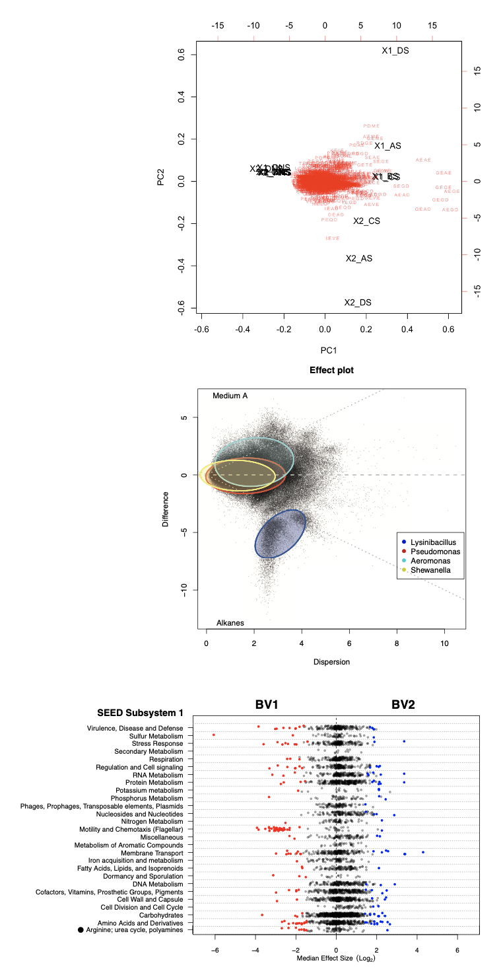
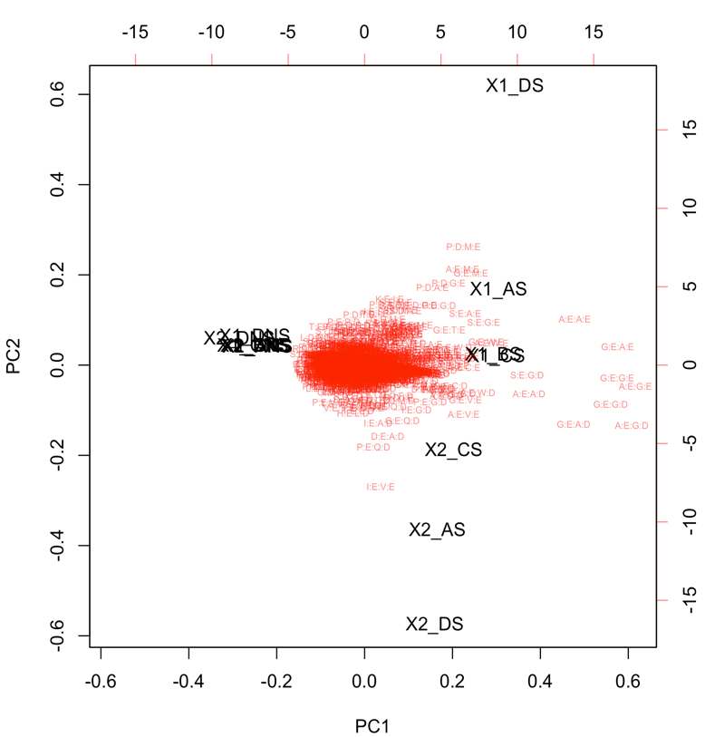
It’s all just sequencing!
Explore
Probabilistic random sample
Ratios not numbers
ALDEx2
CoDaSeq
omicPlotR
Collect DNA
whatever seq
Differential
Fernandes et al. 2014. Unifying the analysis of high-throughput sequencing datasets: characterizing {RNA}-seq, 16{S} r{RNA} gene sequencing and selective growth experiments by compositional data analysis. Microbiome
Gloor et al. 2017. Microbiome Datasets Are Compositional: And This Is Not Optional. Frontiers in Microbiology
Functionalize

Slide 10
Metagenomics at three levels
Low complexity sequencing on the Illumina platform
The importance of understanding the platform
Error rates
Microbiomes in the Chinese population
Reproducibility and stability
Hybrid short-long read analysis of microbiomes
Ecosystem function as a public resource

Slide 11
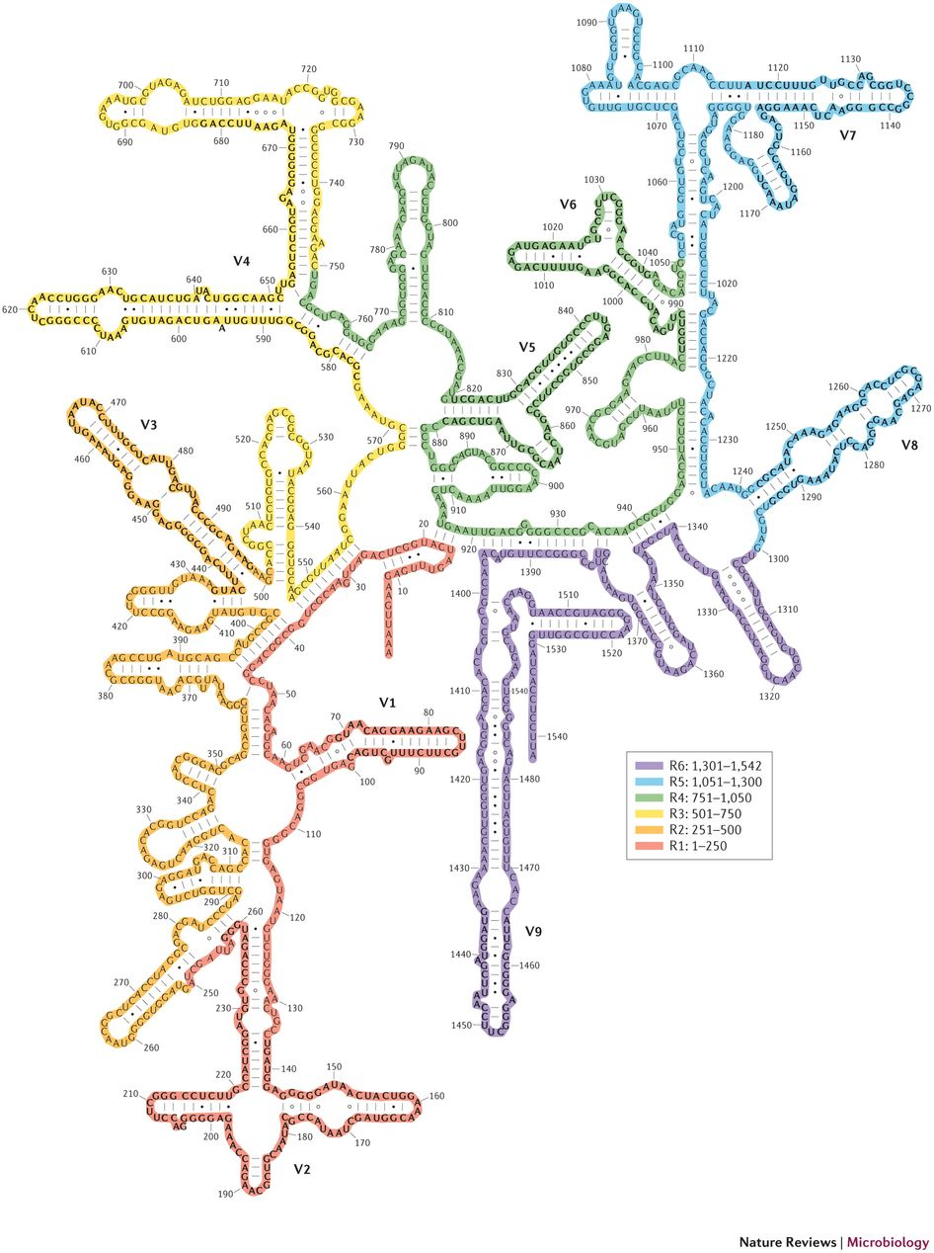
The 16S rRNA gene
Universal gene for bacteria/archaea
Basis of molecular taxonomy of bacteria
Composed of constant and variable regions
Each variable region or combinations thereof can be amplified and sequenced
Each V region has different resolutions for different groupings of species

Slide 12
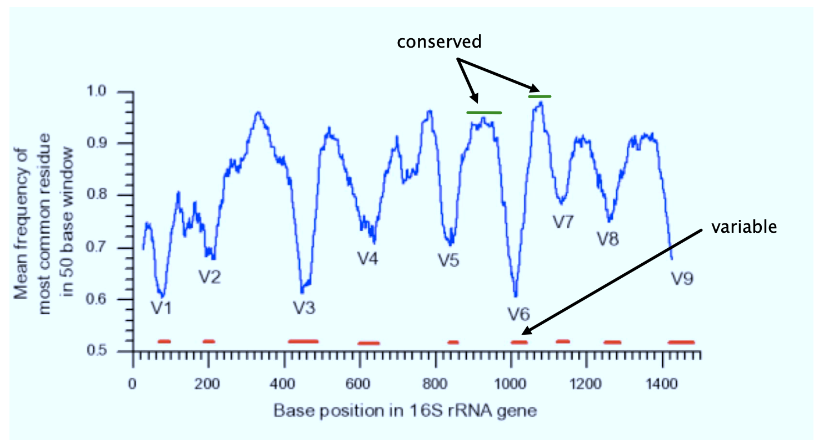
Conserved and variable regions linearly

Slide 14
Sequencing error in the primers
3-4.5 logs
Sources of variation
Mis-synthesis
PCR error (linear)
Library prep error
Sequencing error

Slide 15
OTU error
2.5-
4.5 logs
About 3-5X greater error rate
All of the previous but primer synthesis
PCR error (exponential)
Natural variation
Notes:
Microbiome accepts variant with minimum 2 observations
Genomics requires coverage of > 30
I’ll leave it to you to figure out if the ‘rare biosphere’ can be discovered by 16S rRNA gene sequencing

Slide 16
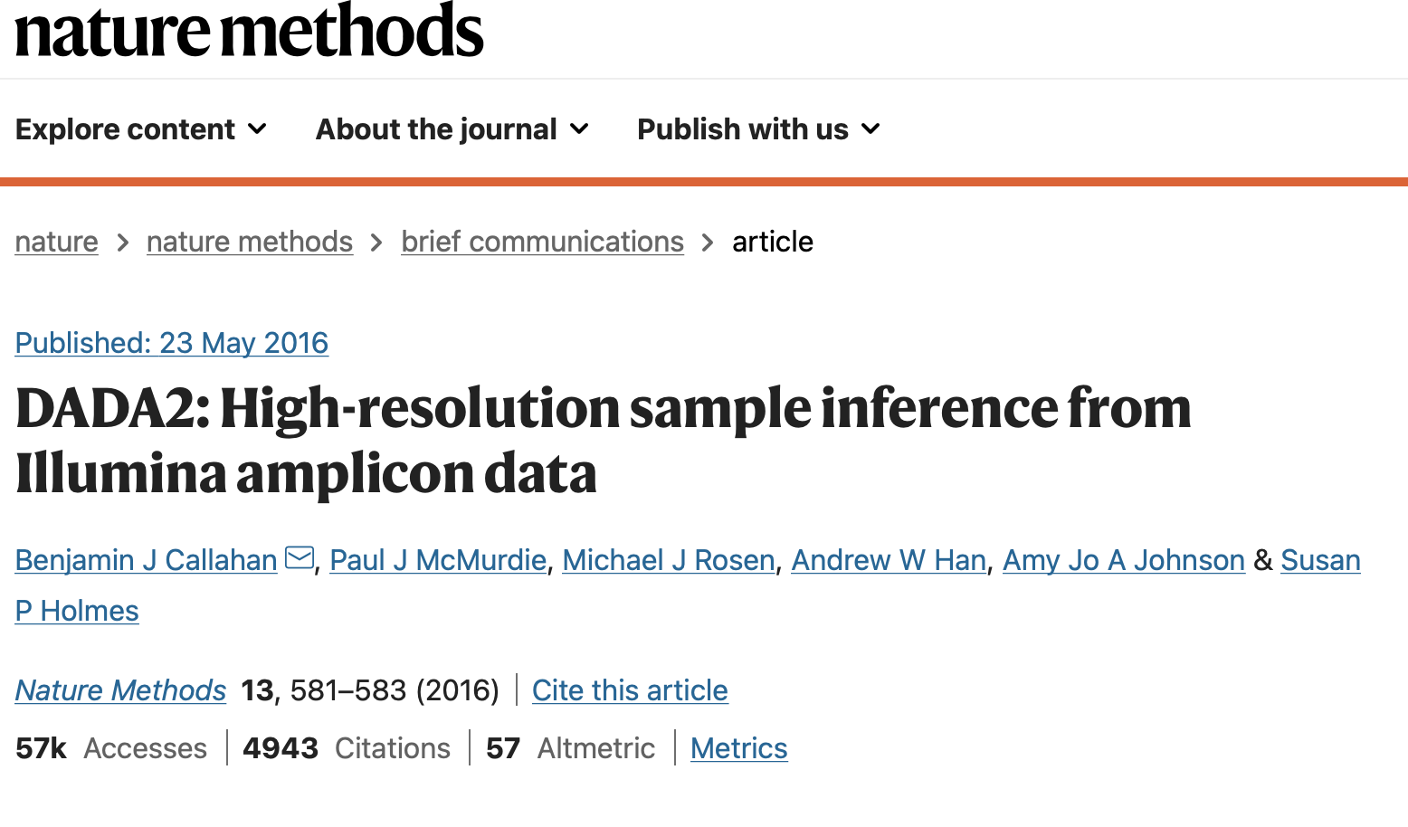
DaDa2 for amplicon sequencing
DaDa2/ASV models chance variants

Slide 17
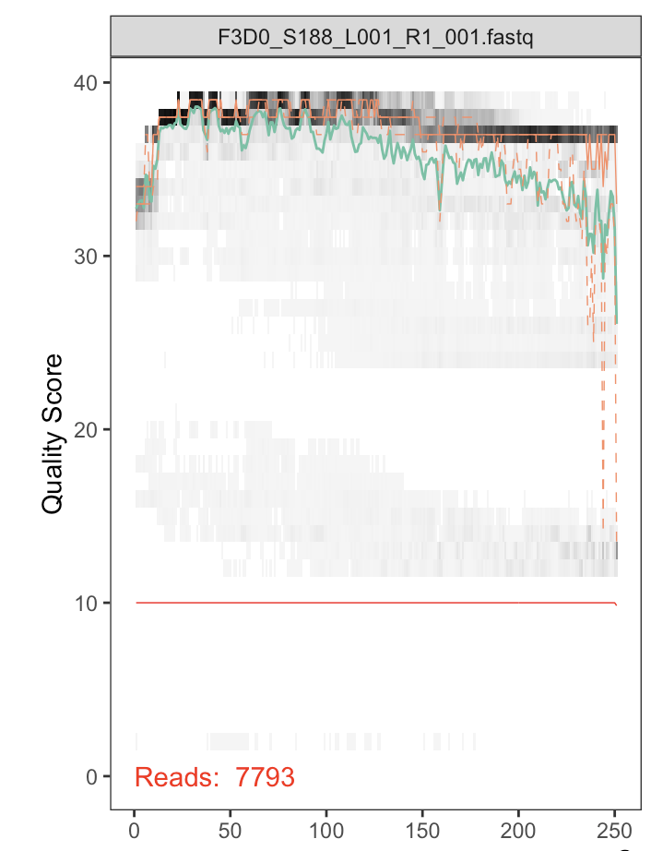
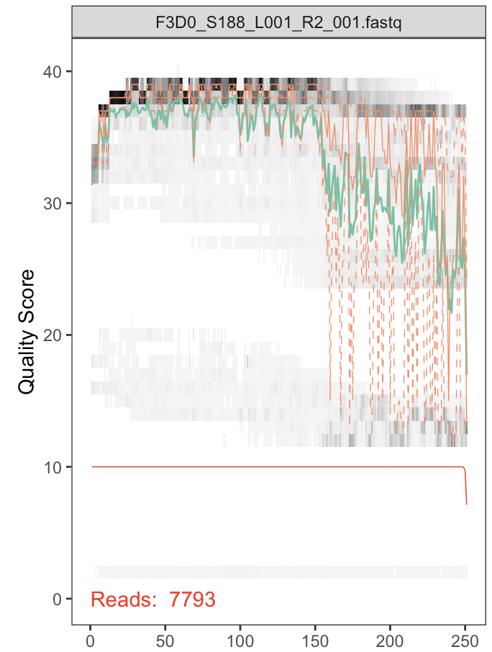
DaDa2 workflow
Examine read error
Model read error
https://benjjneb.github.io/dada2/tutorial.html

Slide 18
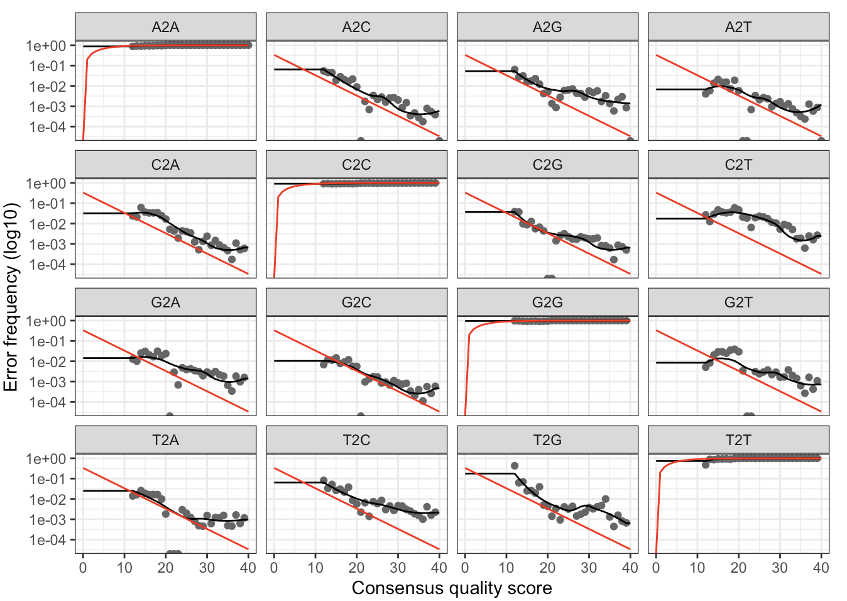
DaDa2 workflow
Examine read error
Model read error
errF <- learnErrors(filtFs, multithread=TRUE)
https://benjjneb.github.io/dada2/tutorial.html
Notes:
The learnErrors method learns this error model from the data, by alternating estimation of the error rates and inference of sample composition until they converge on a jointly consistent solution. As in many machine-learning problems, the algorithm must begin with an initial guess, for which the maximum possible error rates in this data are used (the error rates if only the most abundant sequence is correct and all the rest are errors).
Points are the observed error rates for each consensus quality score. The black line shows the estimated error rates after convergence of the machine-learning algorithm. The red line shows the error rates expected under the nominal definition of the Q-score.

Slide 19
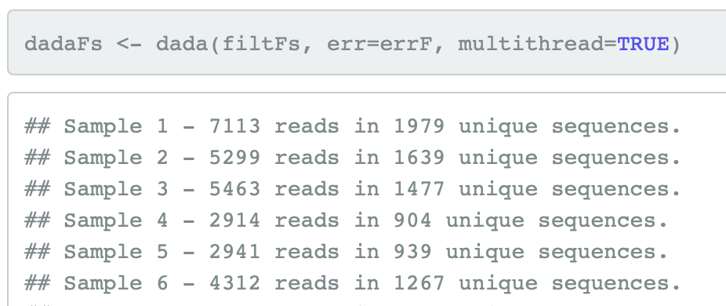
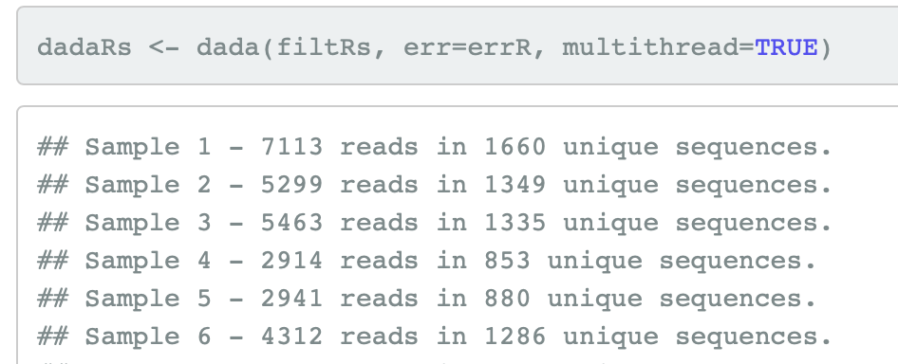
DaDa2 workflow
Examine read error
Model read error
errF <- learnErrors(filtFs, multithread=TRUE)
Apply error model
https://www.nature.com/articles/nmeth.3869
https://benjjneb.github.io/dada2/tutorial.html
Notes:
The learnErrors method learns this error model from the data, by alternating estimation of the error rates and inference of sample composition until they converge on a jointly consistent solution. As in many machine-learning problems, the algorithm must begin with an initial guess, for which the maximum possible error rates in this data are used (the error rates if only the most abundant sequence is correct and all the rest are errors).
Points are the observed error rates for each consensus quality score. The black line shows the estimated error rates after convergence of the machine-learning algorithm. The red line shows the error rates expected under the nominal definition of the Q-score.

Slide 20
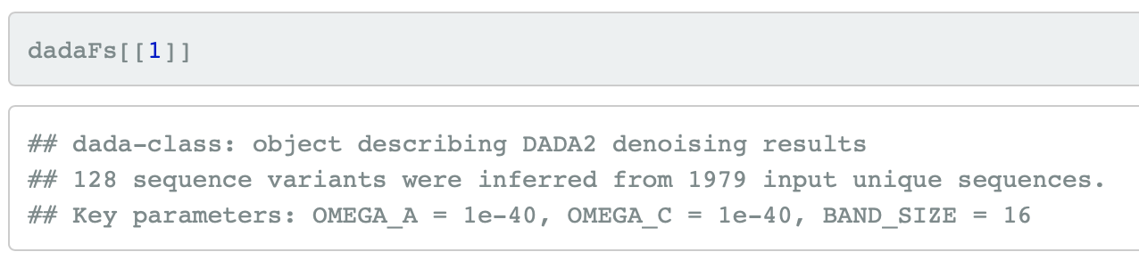
DaDa2 workflow
Examine read error
Model read error
errF <- learnErrors(filtFs, multithread=TRUE)
Apply error model
https://www.nature.com/articles/nmeth.3869
https://benjjneb.github.io/dada2/tutorial.html
Notes:
The learnErrors method learns this error model from the data, by alternating estimation of the error rates and inference of sample composition until they converge on a jointly consistent solution. As in many machine-learning problems, the algorithm must begin with an initial guess, for which the maximum possible error rates in this data are used (the error rates if only the most abundant sequence is correct and all the rest are errors).
Points are the observed error rates for each consensus quality score. The black line shows the estimated error rates after convergence of the machine-learning algorithm. The red line shows the error rates expected under the nominal definition of the Q-score.

Slide 21
DaDa2 workflow
Examine read error
Model read error
errF <- learnErrors(filtFs, multithread=TRUE)
Apply error model
https://www.nature.com/articles/nmeth.3869
https://benjjneb.github.io/dada2/tutorial.html
Notes:
The learnErrors method learns this error model from the data, by alternating estimation of the error rates and inference of sample composition until they converge on a jointly consistent solution. As in many machine-learning problems, the algorithm must begin with an initial guess, for which the maximum possible error rates in this data are used (the error rates if only the most abundant sequence is correct and all the rest are errors).
Points are the observed error rates for each consensus quality score. The black line shows the estimated error rates after convergence of the machine-learning algorithm. The red line shows the error rates expected under the nominal definition of the Q-score.

Slide 22
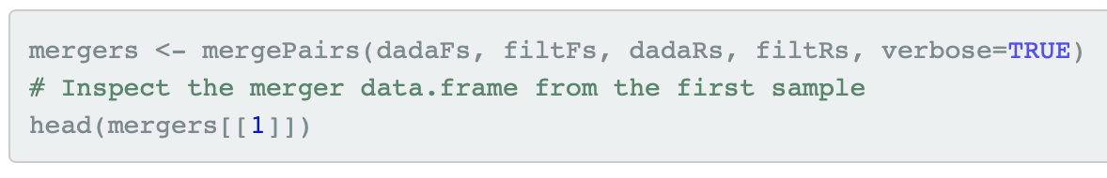
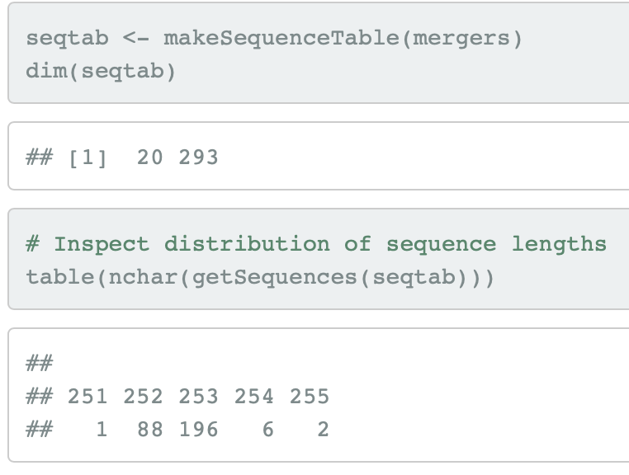
DaDa2 workflow
Examine read error
Model read error
errF <- learnErrors(filtFs, multithread=TRUE)
Apply error model
https://www.nature.com/articles/nmeth.3869
Merge forward/reverse reads
Construct sequence table and sanity check
https://benjjneb.github.io/dada2/tutorial.html
Notes:
The learnErrors method learns this error model from the data, by alternating estimation of the error rates and inference of sample composition until they converge on a jointly consistent solution. As in many machine-learning problems, the algorithm must begin with an initial guess, for which the maximum possible error rates in this data are used (the error rates if only the most abundant sequence is correct and all the rest are errors).
Points are the observed error rates for each consensus quality score. The black line shows the estimated error rates after convergence of the machine-learning algorithm. The red line shows the error rates expected under the nominal definition of the Q-score.

Slide 23
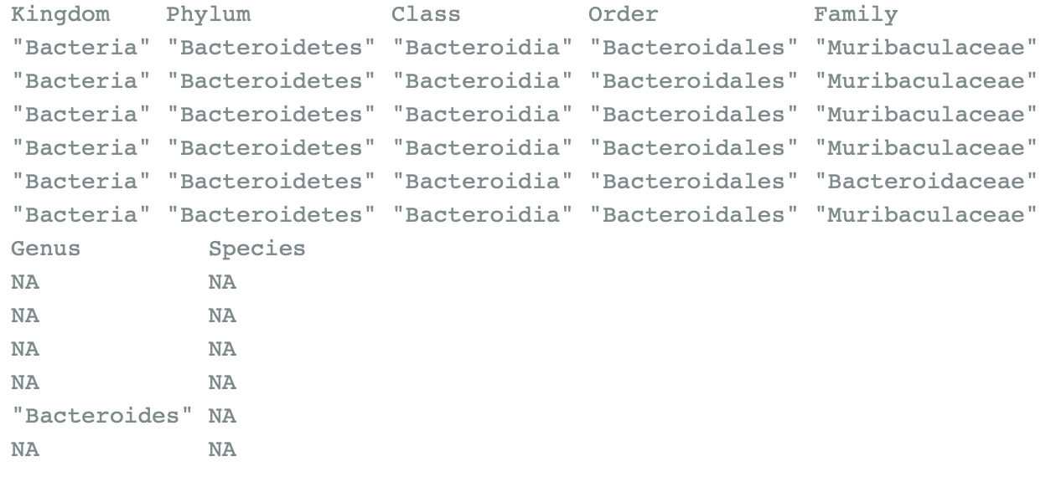
DaDa2 workflow
Examine read error
Model read error
errF <- learnErrors(filtFs, multithread=TRUE)
Apply error model
https://www.nature.com/articles/nmeth.3869
Merge forward/reverse reads
Construct sequence table and inspect
Remove chimeric sequences
Arise during PCR and sequencing
Assign taxonomy
https://benjjneb.github.io/dada2/tutorial.html
Notes:
The learnErrors method learns this error model from the data, by alternating estimation of the error rates and inference of sample composition until they converge on a jointly consistent solution. As in many machine-learning problems, the algorithm must begin with an initial guess, for which the maximum possible error rates in this data are used (the error rates if only the most abundant sequence is correct and all the rest are errors).
Points are the observed error rates for each consensus quality score. The black line shows the estimated error rates after convergence of the machine-learning algorithm. The red line shows the error rates expected under the nominal definition of the Q-score.

Slide 24
We now have a data table
Examine read error
Model read error
errF <- learnErrors(filtFs, multithread=TRUE)
Apply error model
https://www.nature.com/articles/nmeth.3869
Merge forward/reverse reads
Construct sequence table and inspect
Remove chimeric sequences
Arise during PCR and sequencing
Assign taxonomy
https://benjjneb.github.io/dada2/tutorial.html
Notes:
The learnErrors method learns this error model from the data, by alternating estimation of the error rates and inference of sample composition until they converge on a jointly consistent solution. As in many machine-learning problems, the algorithm must begin with an initial guess, for which the maximum possible error rates in this data are used (the error rates if only the most abundant sequence is correct and all the rest are errors).
Points are the observed error rates for each consensus quality score. The black line shows the estimated error rates after convergence of the machine-learning algorithm. The red line shows the error rates expected under the nominal definition of the Q-score.

Slide 25
So now what?
The most important thing is to conduct an exploratory data analysis to determine if there is anything to examine
You can save an enormous amount of time and energy by doing this rather than diving into the analysis
Compositional PCA biplot is the simplest and most useful tool
Notes:
The learnErrors method learns this error model from the data, by alternating estimation of the error rates and inference of sample composition until they converge on a jointly consistent solution. As in many machine-learning problems, the algorithm must begin with an initial guess, for which the maximum possible error rates in this data are used (the error rates if only the most abundant sequence is correct and all the rest are errors).
Points are the observed error rates for each consensus quality score. The black line shows the estimated error rates after convergence of the machine-learning algorithm. The red line shows the error rates expected under the nominal definition of the Q-score.

Slide 26
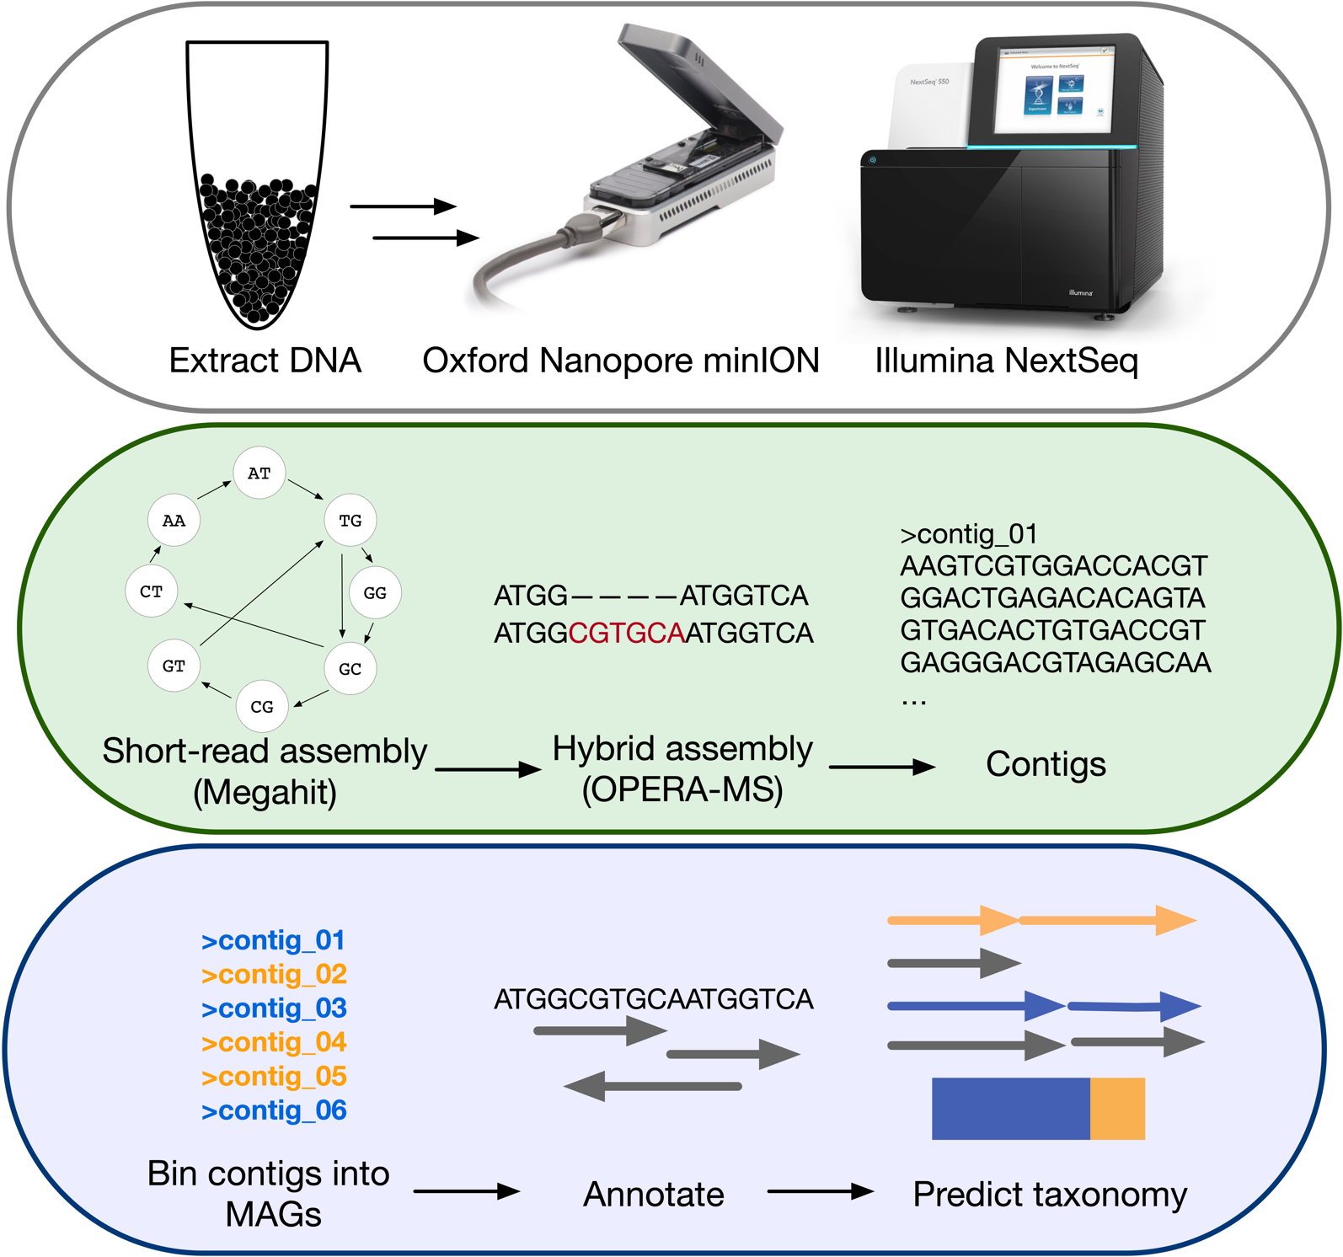
Shotgun sequencing

Slide 27
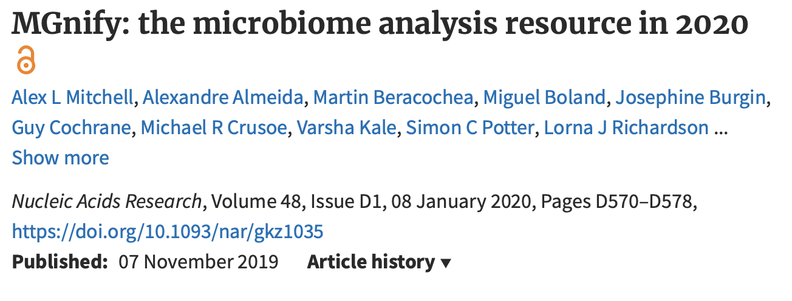

Shotgun sequencing
https://academic.oup.com/nar/article/48/D1/D570/5614179

Slide 28
MGnify at EMBL/EBI
Provides a best-practices based approach to analyzing shotgun sequence data
Neutral party, does not develop tools, but benchmarks and builds workflows
Common workflow language and Docker
Integrated with upstream (ENA) and downstream (UNIProt) databases
Will run analysis pipeline on submitted data
Three separate pipelines
https://www.ebi.ac.uk/metagenomics/
https://academic.oup.com/nar/article/48/D1/D570/5614179

Slide 29
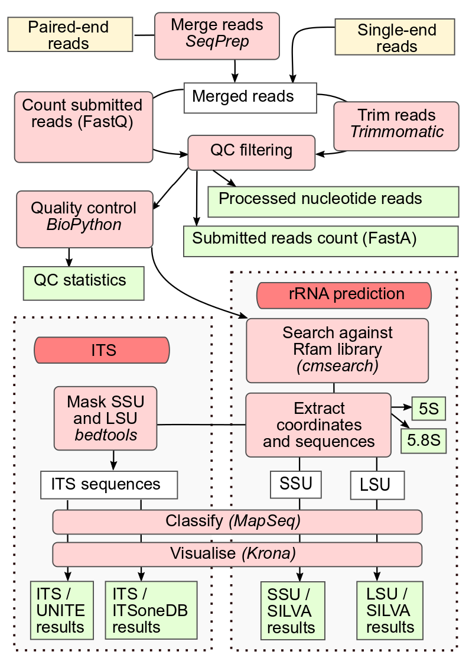
MGnify: 16S/ITS
Extracts reads from shotgun data or can use submitted amplicon
Less rigorous than DaDa2 and is based on exact matching for classification
Publicly searchable database of any data submitted to SRA or ENA
https://academic.oup.com/nar/article/48/D1/D570/5614179

Slide 30
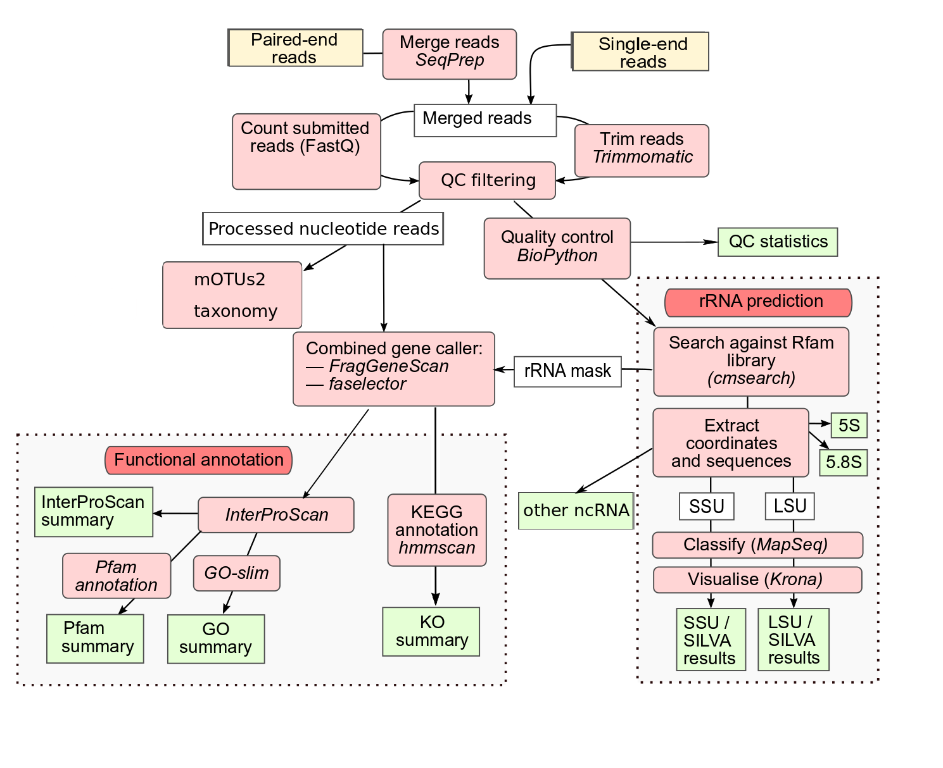
MGnify: raw read functions
Reads from shotgun
Functionalized at read level
FragGeneScan
InterProScan then subset to Pfam and GO
Outputs a table of functions by read
rRNA extracted and run through rRNA pipeline
Publicly searchable database of any data submitted to SRA or ENA
https://academic.oup.com/nar/article/48/D1/D570/5614179

Slide 31
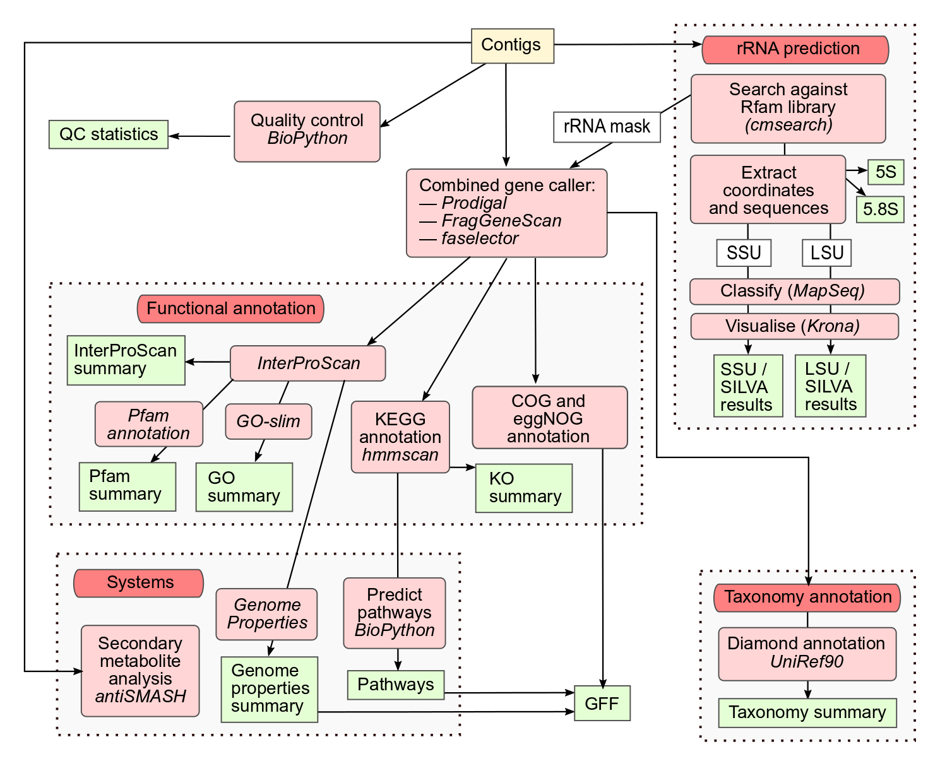
MGnify: contigs functions
Contigs assembled from shotgun
Outside of MGnify
Functionalized at ORF level
Orfs identified by Prodigal
InterProScan then subset to Pfam and GO
Can use COGs and eggNOG
Outputs a table of functions
Extends to systems and pathway analysis and GFF generation
Publicly searchable database of any data submitted to SRA or ENA
https://academic.oup.com/nar/article/48/D1/D570/5614179

Slide 32
Analyzing functionalized meta-seq ‘omes
A sequence is a sequence is a sequence
A data table is a data table is a data table
Macklaim & Gloor 2018. From RNA-seq to Biological Inference: Using Compositional Data Analysis in Meta-Transcriptomics. Meth. Mol. Bio.
Gloor, Macklaim, Fernandes, 2016. Displaying Variation in Large Datasets: Plotting a Visual Summary of Effect Sizes. J. of Comp. and Graph. Statistics

Slide 33
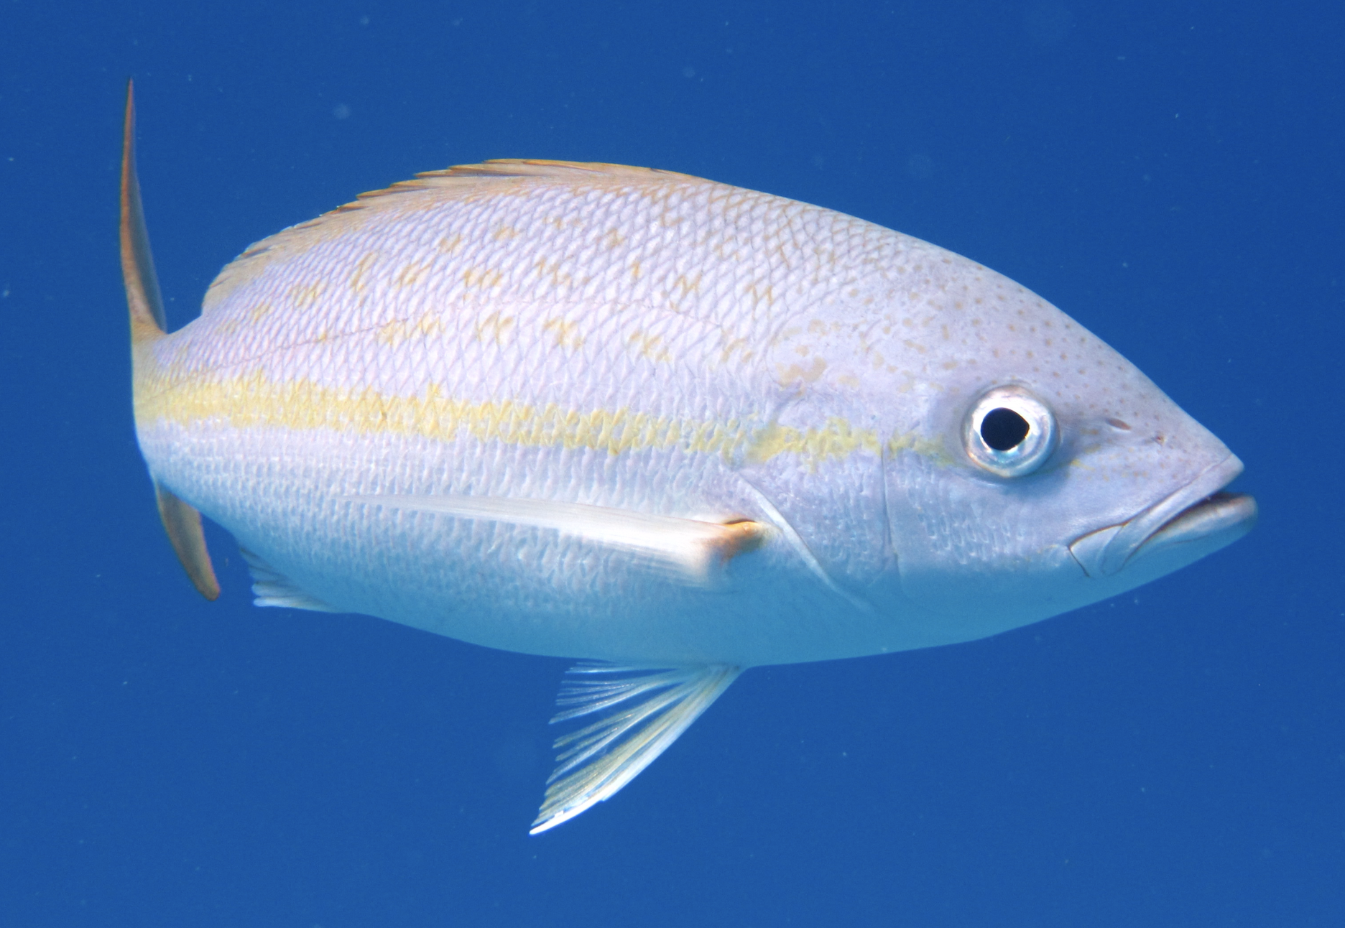
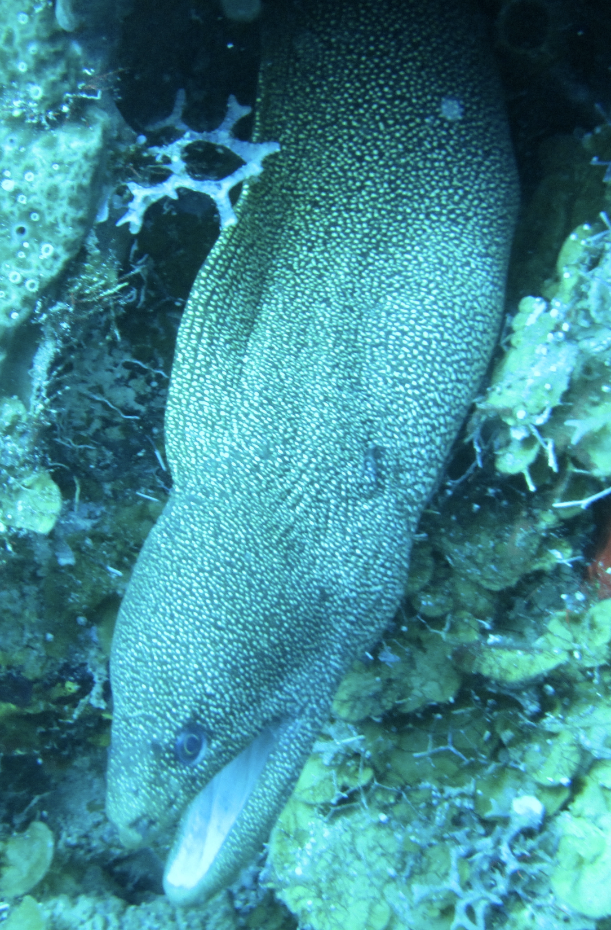

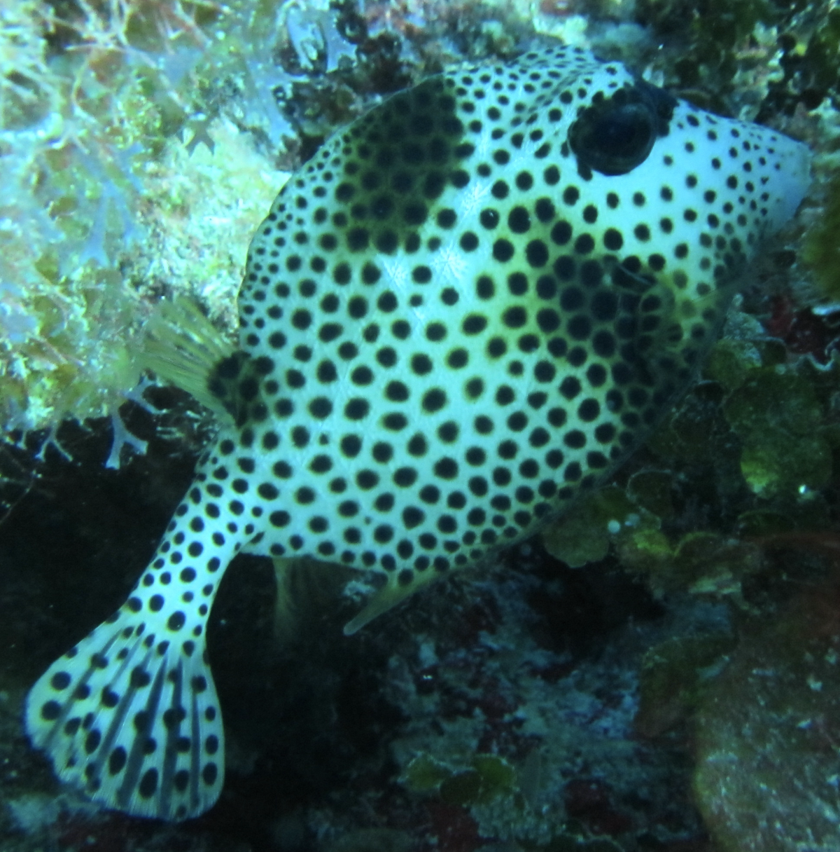

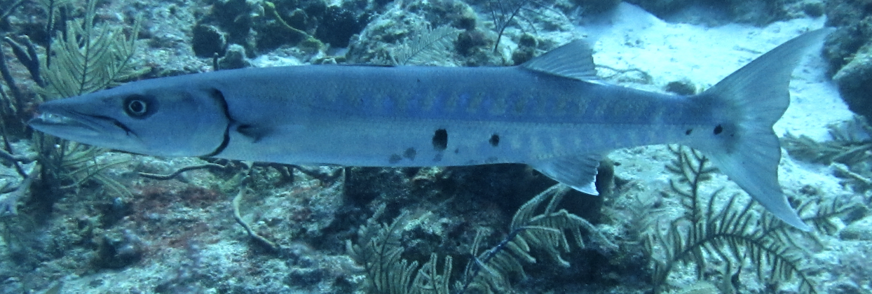
Interlude!

Slide 34
Compositional data and sequencing
Data are not counts as you imagine
The machine has a capacity
We are observing ~ integer representation of the probability of pulling that read from the library scaled by the number of reads or the ‘library size’
so must ‘normalize’ the data somehow
Centre – assumes most do not change
Reference – assumes reference is unchanged
Normalize to a centre
TMM (edgeR)
RLE (DESeq2)
CLR (ALDEx2)
Normalize to reference
Spike-in
housekeeping
Notes:
The learnErrors method learns this error model from the data, by alternating estimation of the error rates and inference of sample composition until they converge on a jointly consistent solution. As in many machine-learning problems, the algorithm must begin with an initial guess, for which the maximum possible error rates in this data are used (the error rates if only the most abundant sequence is correct and all the rest are errors).
Points are the observed error rates for each consensus quality score. The black line shows the estimated error rates after convergence of the machine-learning algorithm. The red line shows the error rates expected under the nominal definition of the Q-score.

Slide 35
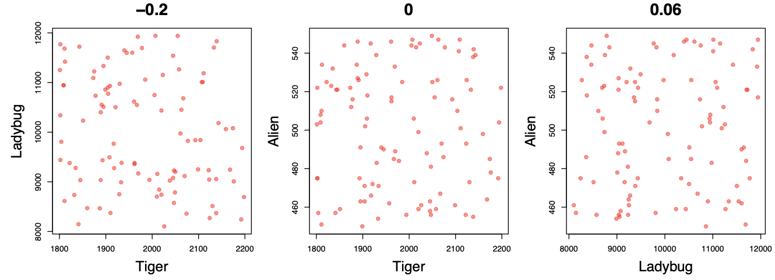
Data as counts
Example 100 random sample sets
range=1800-2200
range= 8000-12000
range=450-550
🐯
🐞
👽
Gloor et al Front. Micro. 2017

Slide 36
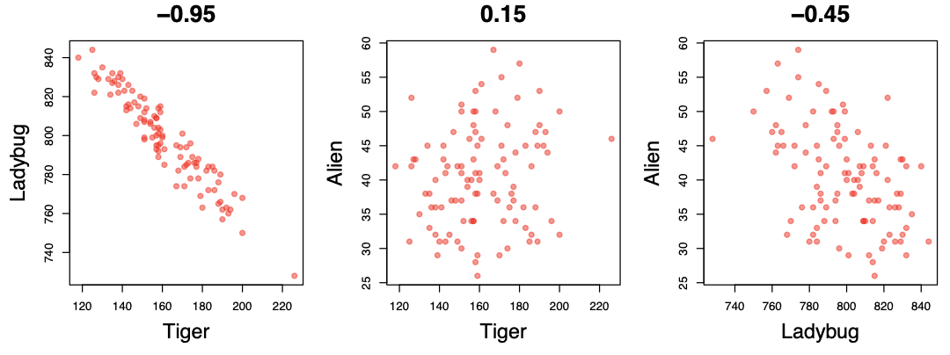
As delivered by sequencing
Constant sum of 1000
Constant sum operations:
Count normalization
Rarefaction
Proportion
percentage, relative abundance
Sequencing
Simplex: one fewer dimensions than variables
Problems remain regardless of dimension
Gloor et al Front. Micro. 2017

Slide 37
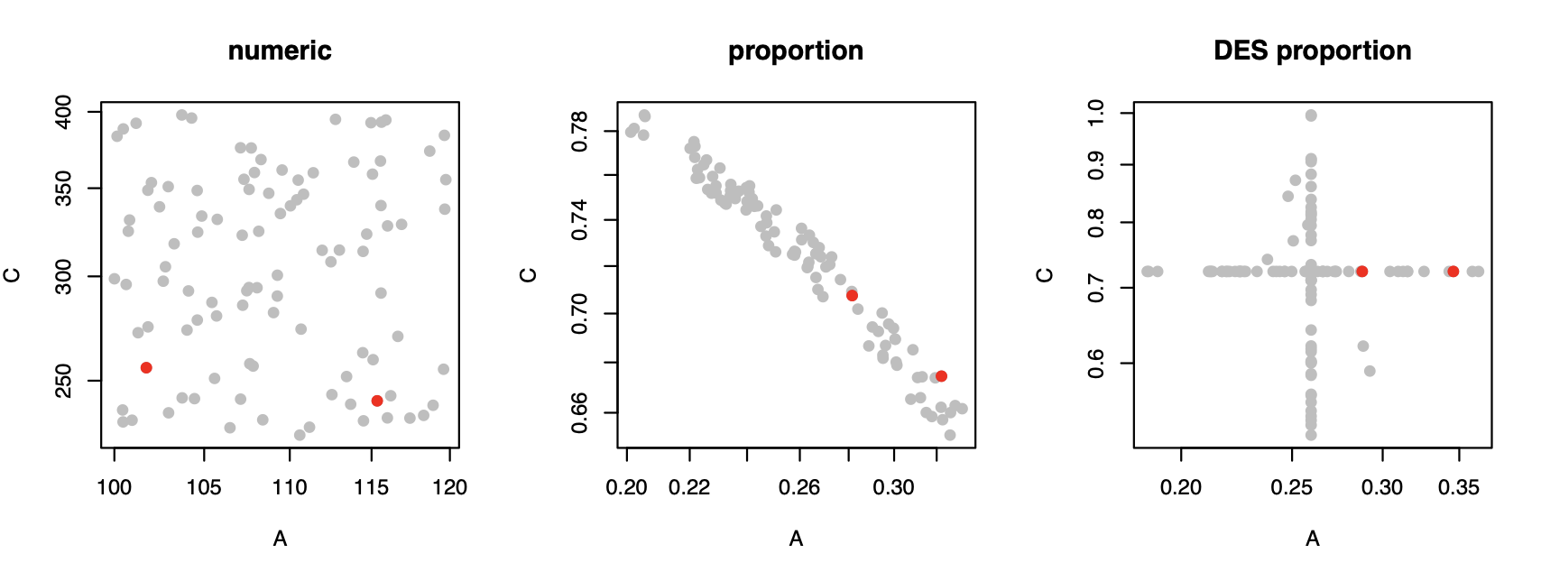
Normalization is no help at all
Once data are on the simplex, they cannot be removed easily

Slide 38
Log-ratios for CoDa
Count
Sequencing
Simplex
27
853
66
740
112
216
clr(x) = [ log(x₁/g_{X}), log(x₂/g_{X}), … log(x_{D}/g_{X}) ]
X = [ x₁, x₂, … x_{D} ], g_{X} = geometric mean of X
Aitchison 1986. Stat. Anal. Comp Data
Pawlowsky-Glahn, 2015. Mod. Anal. CoDa
Notes:
Scale dependence - hence ‘normalization’
Correlation and covariation are unreliable
Addition and subtraction are not useful operations
Subsetting and aggregating are problematic
Sparse data is an issue

Slide 39
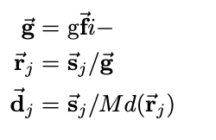
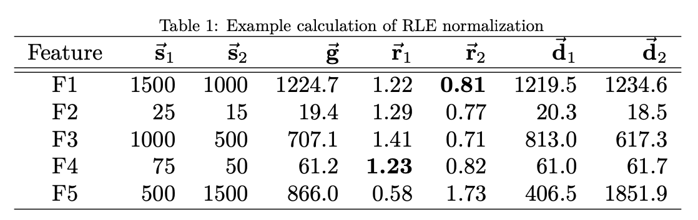
RLE for ‘library size’
s – sequence counts
g_{f} – G of row
r – s/g_{f}
d – ‘normalized counts’
Aitchison 1986. Stat. Anal. Comp Data
Pawlowsky-Glahn, 2015. Mod. Anal. CoDa
Notes:
Scale dependence - hence ‘normalization’
Correlation and covariation are unreliable
Addition and subtraction are not useful operations
Subsetting and aggregating are problematic
Sparse data is an issue

Slide 40
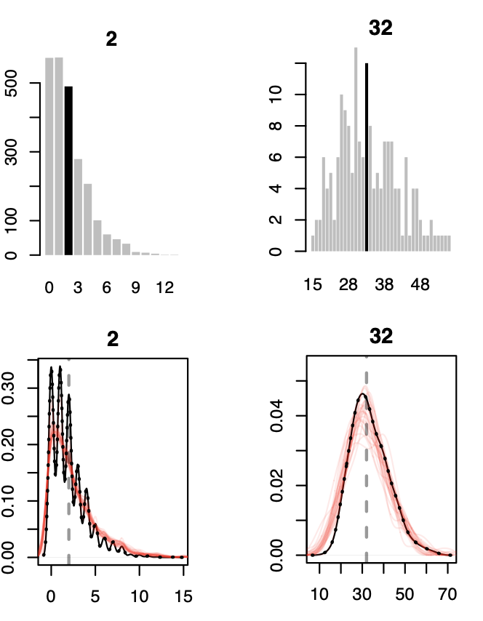
Real sequence data are variable
Same features from same samples from the same library
Sequenced on different lanes
We should get comparable answers
We can estimate the variability by sampling Dirichlet instances
Multivariate, constrained balls in an urn
Fernandes, PLoS ONE 2013
Gloor, Aus J. Stat. 2016

Slide 41
Think of the 0s!
0 count can be real – or a non-detect
0 count is not 0 probability to detect the count
p_{i} = 0 is strong, invalid, assumption
[P_{i} > 0, P_{i} →0]
Fernandes, PLoS ONE 2013
Gloor, Aus J. Stat. 2016
EBI Hinxton

Slide 42
Compositional data and sequencing
Normalize to a centre
0 values may interfere if very common
Log(RLE) ~ CLR but 0’s treated differently
Normalize to reference
Spike-in ~ Housekeeping ~ qPCR
Interpretation should always be ‘what changes relative to the reference?’
Notes:
The learnErrors method learns this error model from the data, by alternating estimation of the error rates and inference of sample composition until they converge on a jointly consistent solution. As in many machine-learning problems, the algorithm must begin with an initial guess, for which the maximum possible error rates in this data are used (the error rates if only the most abundant sequence is correct and all the rest are errors).
Points are the observed error rates for each consensus quality score. The black line shows the estimated error rates after convergence of the machine-learning algorithm. The red line shows the error rates expected under the nominal definition of the Q-score.

Slide 43
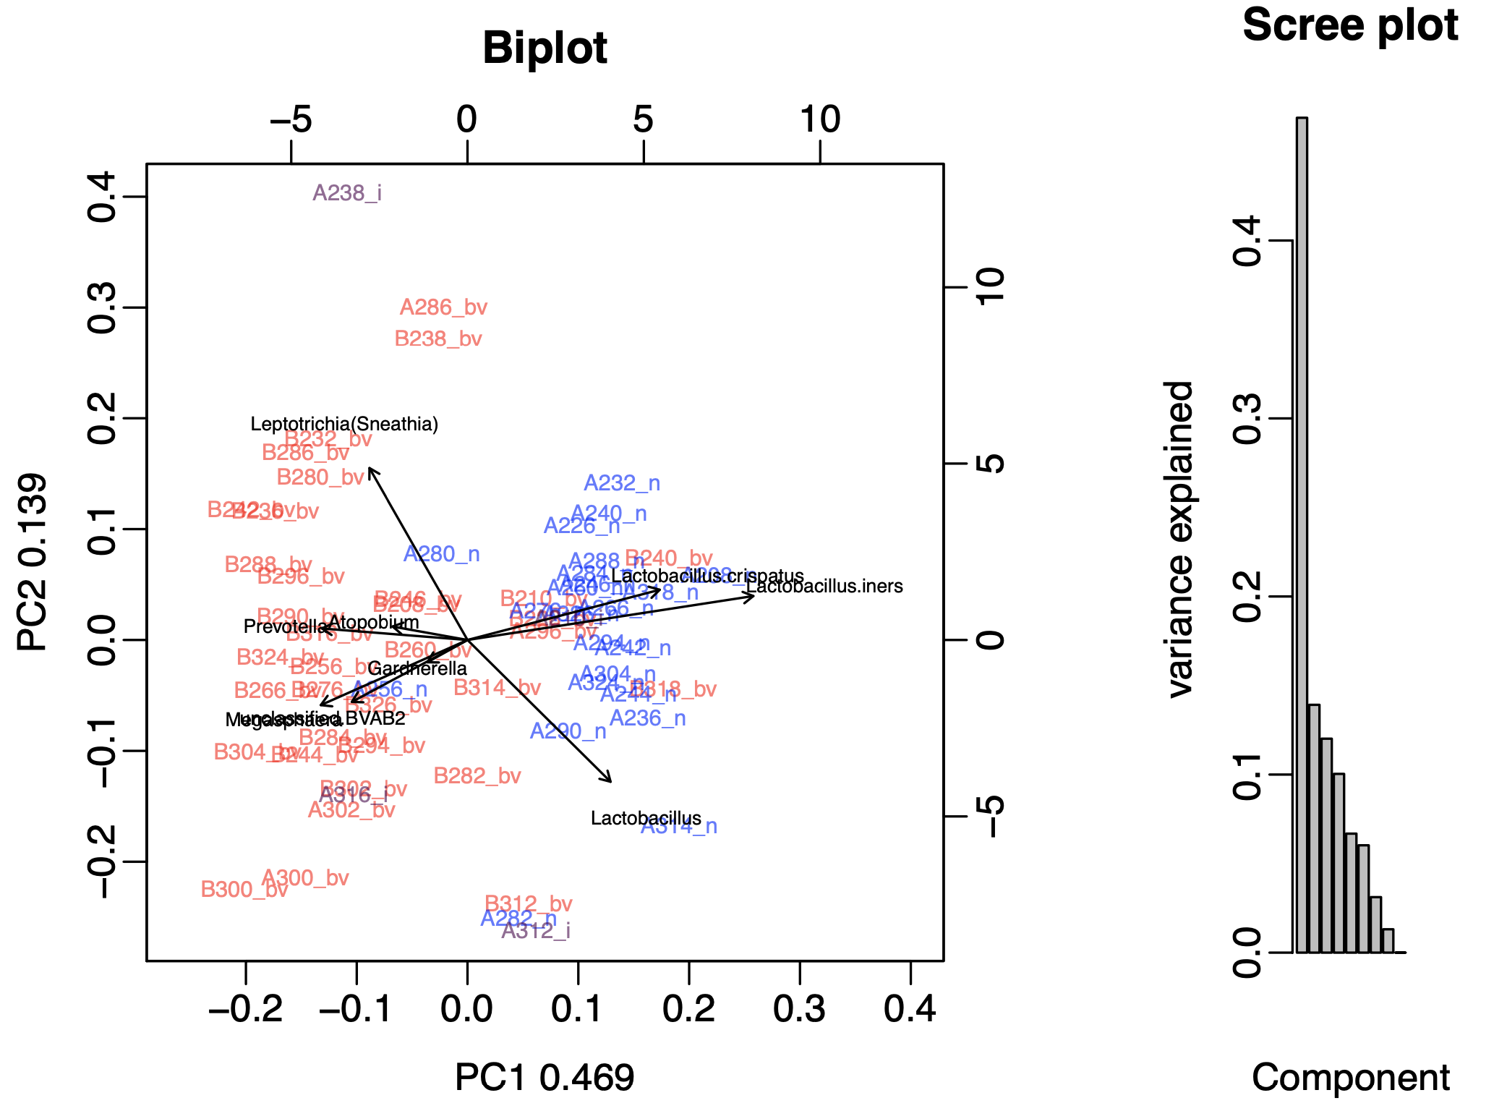
Compositional PCA biplot
The most important thing is to conduct an exploratory data analysis to determine if there is anything to examine
You can save an enormous amount of time and energy by doing this rather than diving into the analysis
Compositional PCA biplot is the simplest and most useful tool
Notes:
The learnErrors method learns this error model from the data, by alternating estimation of the error rates and inference of sample composition until they converge on a jointly consistent solution. As in many machine-learning problems, the algorithm must begin with an initial guess, for which the maximum possible error rates in this data are used (the error rates if only the most abundant sequence is correct and all the rest are errors).
Points are the observed error rates for each consensus quality score. The black line shows the estimated error rates after convergence of the machine-learning algorithm. The red line shows the error rates expected under the nominal definition of the Q-score.

Slide 44
Compositional PCA biplot
Data
Do something with 0 either pseudocount, imputation, or removal
CLR or other transform
Best not to use RLE or TMM as reference changes with each sample
Generate a prcomp() object in R
Use plot() and biplot() functions to explore
Notes:
The learnErrors method learns this error model from the data, by alternating estimation of the error rates and inference of sample composition until they converge on a jointly consistent solution. As in many machine-learning problems, the algorithm must begin with an initial guess, for which the maximum possible error rates in this data are used (the error rates if only the most abundant sequence is correct and all the rest are errors).
Points are the observed error rates for each consensus quality score. The black line shows the estimated error rates after convergence of the machine-learning algorithm. The red line shows the error rates expected under the nominal definition of the Q-score.

Slide 45
Compositional PCA biplot
There are as many dimensions as n-1 of the samples or variables: whichever is less
Scree plot gives proportion of variance (information) explained by each orthogonal data axis
In totally random data we expect to see a linear loss of information with increasing dimension
Notes:
The learnErrors method learns this error model from the data, by alternating estimation of the error rates and inference of sample composition until they converge on a jointly consistent solution. As in many machine-learning problems, the algorithm must begin with an initial guess, for which the maximum possible error rates in this data are used (the error rates if only the most abundant sequence is correct and all the rest are errors).
Points are the observed error rates for each consensus quality score. The black line shows the estimated error rates after convergence of the machine-learning algorithm. The red line shows the error rates expected under the nominal definition of the Q-score.

Slide 46
Compositional PCA biplot
Each arrow is a species
Position of species is determined by variance between samples
E.g. L. iners is highly variable and enriched in the blue samples
Angle between arrows is ~ Pearson’s correlation with low angles meaning higher correlation
Length of arrow is ~ variance
Distance between arrow tips ~ ratio of variance between species
E.g. Megasphaera and BVAB2 are highly correlated, have similar variance and so have a near constant ratio in the dataset
Arrow tips on the same line have an inverse relationship
E.g. P, A are inversely related to Lc, Li
Large angles or large distances have no meaningful interpretation
Notes:
The learnErrors method learns this error model from the data, by alternating estimation of the error rates and inference of sample composition until they converge on a jointly consistent solution. As in many machine-learning problems, the algorithm must begin with an initial guess, for which the maximum possible error rates in this data are used (the error rates if only the most abundant sequence is correct and all the rest are errors).
Points are the observed error rates for each consensus quality score. The black line shows the estimated error rates after convergence of the machine-learning algorithm. The red line shows the error rates expected under the nominal definition of the Q-score.

Slide 47
Compositional PCA biplot
Each label is a sample
Colored by group; red or blue
Distance between samples ~ Euclidian distance with clr transformed data
But precision is dependent on the %variance explained on the axes (here ~60% total)
So here we still have some imprecision in distance estimation but the majority of red and blue samples are well separated
Notes:
The learnErrors method learns this error model from the data, by alternating estimation of the error rates and inference of sample composition until they converge on a jointly consistent solution. As in many machine-learning problems, the algorithm must begin with an initial guess, for which the maximum possible error rates in this data are used (the error rates if only the most abundant sequence is correct and all the rest are errors).
Points are the observed error rates for each consensus quality score. The black line shows the estimated error rates after convergence of the machine-learning algorithm. The red line shows the error rates expected under the nominal definition of the Q-score.

Slide 48
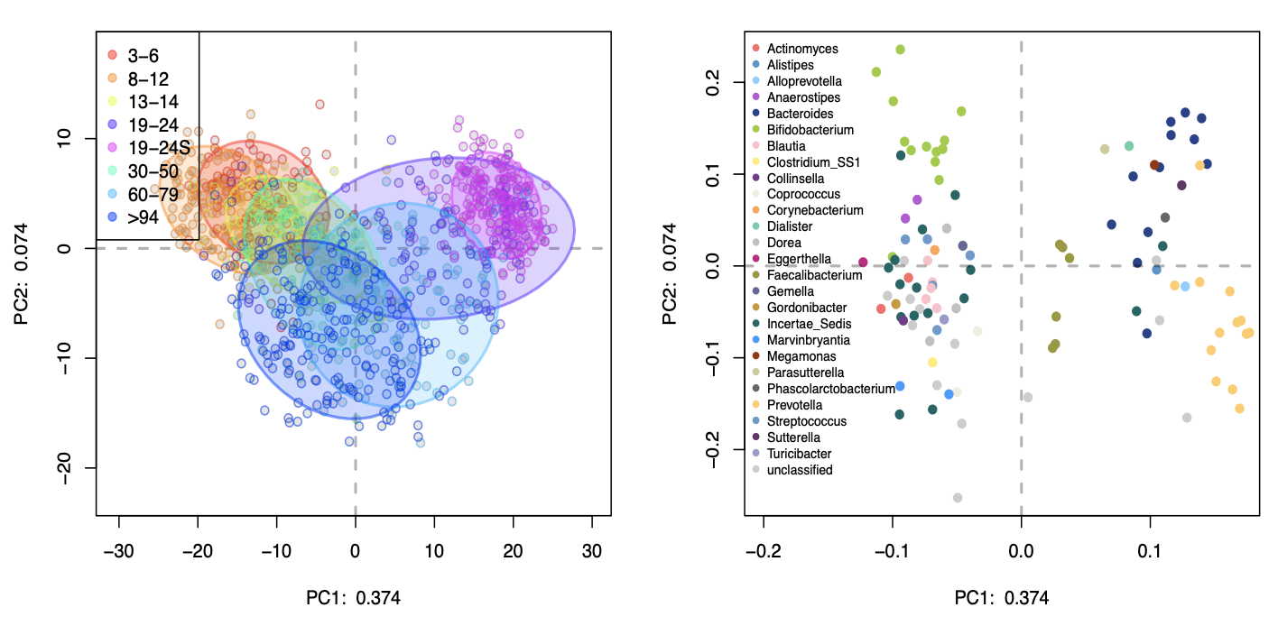

Slide 49
The approximate difference can be inferred from the biplot.
Features near the middle have low variance and so should have low difference between groups
Features near the edges have low variance and so should have high difference between groups
The difference could be ‘significant’ if the dispersion of this difference is small

Slide 50
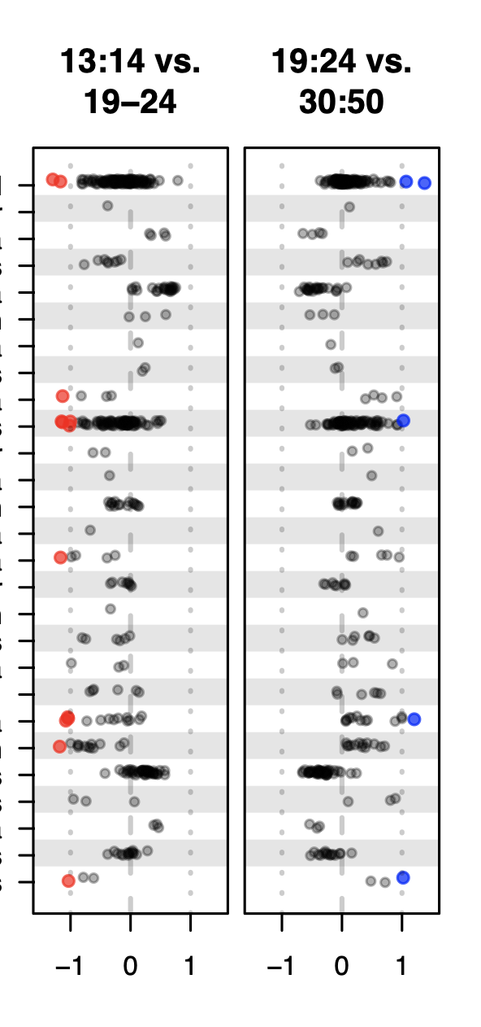
Internally consistent results

Slide 51
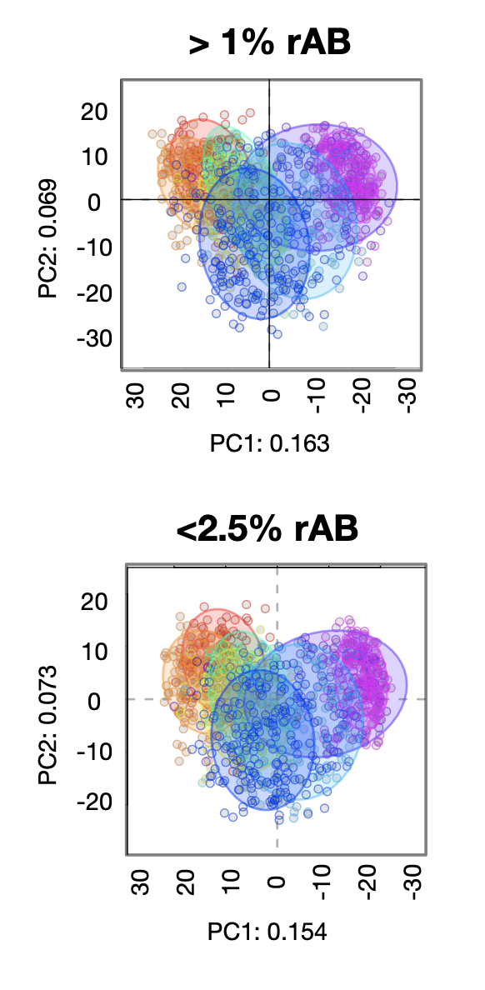
Stable to sub/supersetting

Slide 52
Conclusions
Sequencing is not a swiss army knife
What people use is an accident of their training
You must understand the technology from end-to-end
It’s all the same data
Sometimes it doesn’t matter
But when methods fail you won’t know
There are principled ways of dealing with sequencing data

